Slide 1
E-commerce Product Delivery Prediction
- By Abdul Hadi S

Slide 2
Agenda
Project Objective
Dataset Overview
Data Preprocessing
Exploratory Data Analysis (EDA)
Machine Learning Models
Model Selection & Performance Comparison
Model Deployment (Streamlit.app)
Key Insights and Recommendation
Conclusion

Slide 3
Project objective
Predicting Delivery Timeliness:
Develop a machine learning model to predict whether an e-commerce product will be delivered on time or delayed based on various factors.
Understanding Key Influencing Factors:
Analyze how attributes like product weight, discount offered, customer behavior, and shipment mode impact delivery time.
Enhancing Business Decision-Making:
Help e-commerce companies optimize logistics, improve customer satisfaction, and reduce delivery delays by identifying trends in shipping efficiency.

Slide 4
Dataset Overview
Dataset Summary:
Total Records: 10,999 rows
Total Features: 12 columns
Target Variable: Reached.on.Time_Y.N
1 = On-time Delivery
0 = Delayed Delivery
Key Attributes & Their Importance:
Warehouse_block – Shipment source location (A to F).
Mode_of_Shipment – Transport method (Ship, Flight, Road).
Discount_offered – Promotional discounts applied.
Product_importance – Importance level (Low, Medium, High).
Weight_in_gms – Product weight affecting delivery speed.
Customer_care_calls – Number of calls related to the order.
ID- Customer ID
Customer_rating- Ratings given by customer
Cost_of_the_Product – Product cose
Prior_purchases- Number of prior purchase
Gender
ID | Warehouse_block | Mode_of_Shipment | Customer_care_calls | Customer_rating | Cost_of_the_Product | Prior_purchases | Product_importance | Gender | Discount_offered | Weight_in_gms | Reached.on.Time_Y.N
1 | D | Flight | 4 | 2 | 177 | 3 | low | F | 44 | 1233 | 1
2 | F | Flight | 4 | 5 | 216 | 2 | low | M | 59 | 3088 | 1
3 | A | Flight | 2 | 2 | 183 | 4 | low | M | 48 | 3374 | 1

Slide 5
Data Preprocessing
Why Data Preprocessing?
Improves data quality for better model performance.
Handles inconsistencies, missing values, and categorical data.
Handling Missing Values:
Checked for missing values using →[df.isnull().sum()]
No missing values found in the dataset.
Encoding Categorical Variables:
Converted categorical variables into numerical format for model training:
Mode_of_Shipment, Warehouse_block, Product_importance
Used Label Encoding where needed.

Slide 6
Data Preprocessing
Outlier Detection & Handling Findings:
Discount Offered had 2,209 outliers (not treated).Prior Purchases had 1,003 outliers, handled using Robust Scaler.
Why not remove discount outliers?
Discounts can be high due to business strategy, removing them may lose critical insights.
Feature Scaling:
Applied Standardization (Z-score Normalization) to Weight_in_gms and Cost_of_the_Product.
Ensures all numerical values are on the same scale. Train-Test Split80% Training Data20% Testing Data

Slide 7
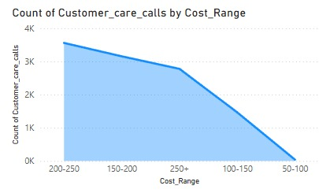
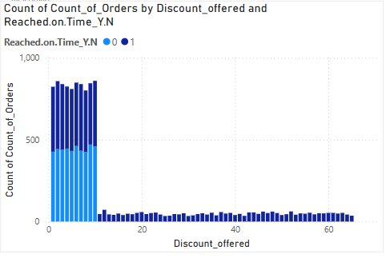
Exploratory Data Analysis
Discount vs Order Count & Delivery:
Most orders occur with 0-10% discount; higher discounts have fewer orders.
Late deliveries are frequent in the 0-10% discount range.
Customer Care Calls vs Cost Range:
₹200-250 orders generate the most customer calls.
Calls decrease as cost range drops.

Slide 8
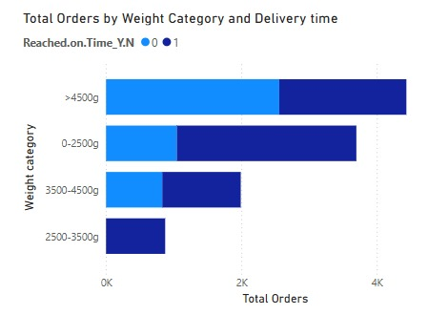
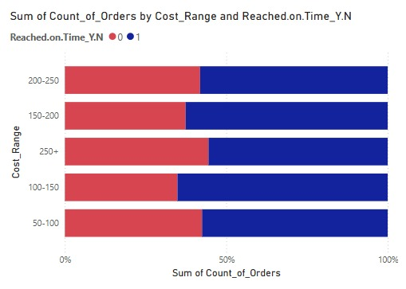
Exploratory Data Analysis
Order Volume by Weight & Delivery:
Heavier orders (>4500g) have the most shipments.
Late deliveries increase with weight.
Logistic improvements needed for bulky shipments.
Order Count by Cost & Delivery:
₹200-250 orders face the most delays.
₹50-150 orders have better on-time rates.
Priority handling needed for costly orders.

Slide 9
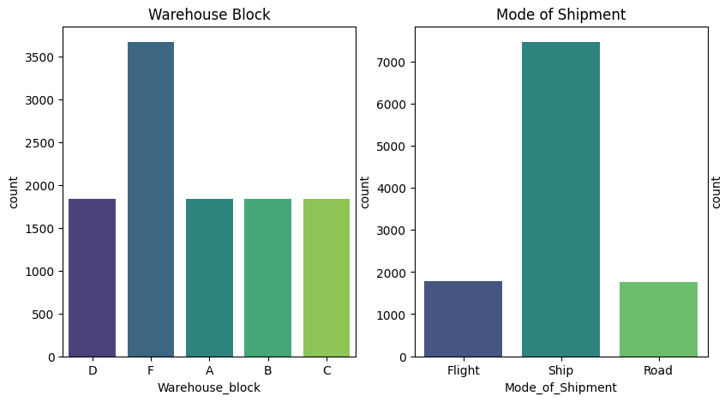
Exploratory Data Analysis
Products shipped via ship is high.
Warehouse F Has sold most number of products.
From this distribution, we get to know that warehouse F is near seaport. Hence it has sold more products when compared to others.

Slide 10
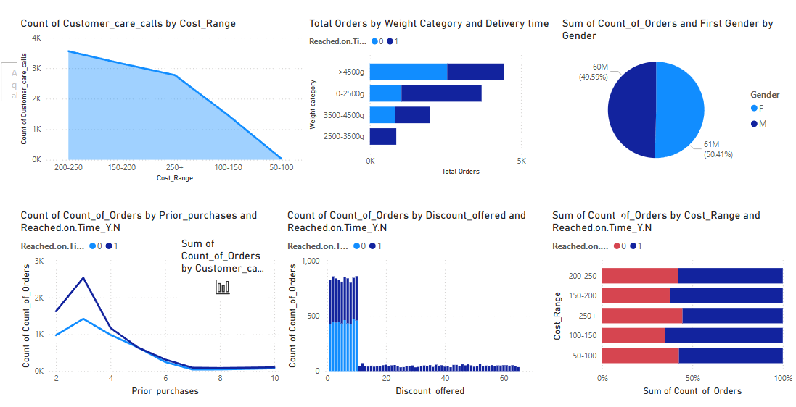
Overall Visualization

Slide 11
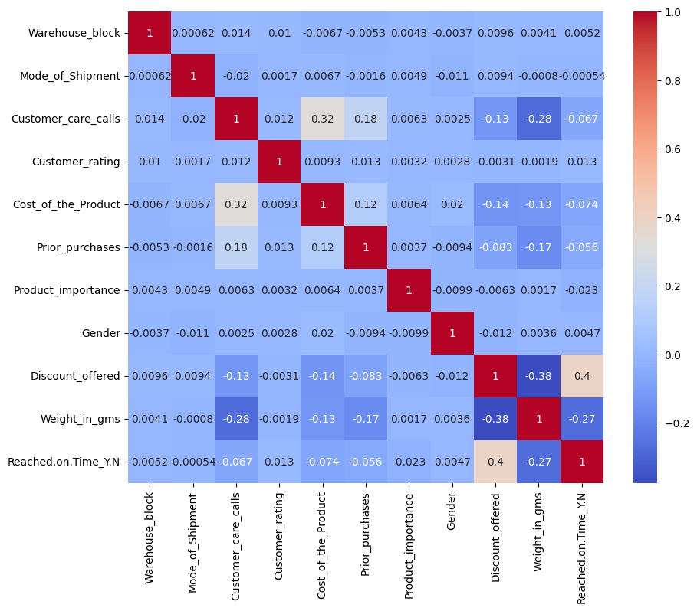
Correlation Analysis
Discount Offered & On-Time Delivery (-0.40):
Higher discounts are linked to delayed deliveries.
Possible reasons: Discounted products may have longer shipping times or stock issues.
Weight of Product & Delivery Time (-0.27):
Heavier packages tend to arrive late.
This suggests logistics challenges with bulky shipments.
Customer Care Calls & Cost of Product (0.32):
Expensive products receive more customer inquiries.
Could indicate concerns about product quality or delivery status.

Slide 12
Machine learning Models
Models Used:
Tree-Based Models: Decision Tree, Random Forest Other Classifiers: Logistic Regression, K-Nearest Neighbors (KNN), Support Vector Machine (SVM) Boosting Model: XGBoost , Gradient Boosting
Evaluation Metrics:
Accuracy – Measures overall prediction correctness. AUC (Area Under Curve) – Assesses model discrimination ability. Precision & Recall – Evaluates prediction quality. F1-Score – Balances Precision and Recall. Training Time – Important for performance efficiency.
Before Model Building:
Scaled all the features with standard scalar And Training 80% and Test 20%
Using SMOTE to Balance the target

Slide 13
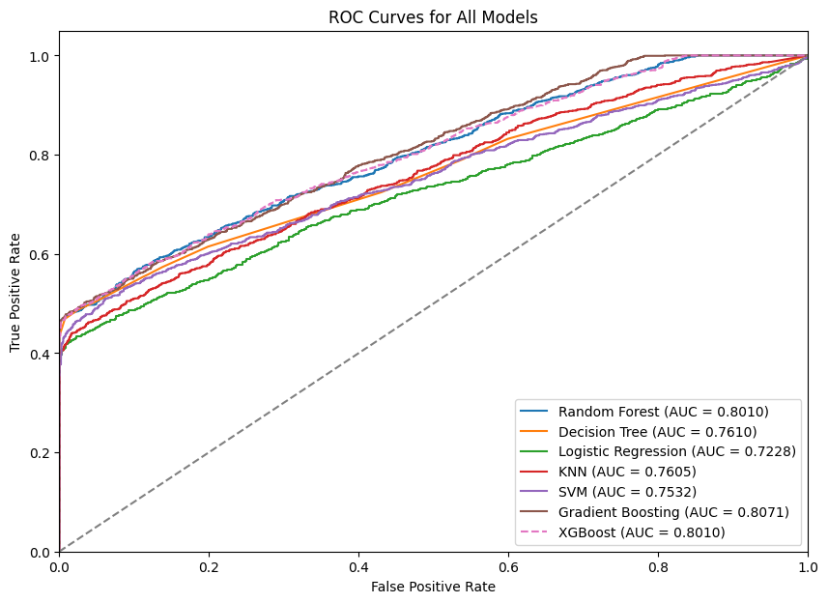
Model Evaluation
We have done model evaluation by plotting ROC curves and confusion matrix for XGBoost.

Slide 14
Model Performance
Model | Accuracy | AUC | Training Time
XGBoost | 73.31% | 80.10% | 0.79 sec
Random Forest | 73.15% | 80.57% | 220.93 sec
Gradient Boosting | 73.12% | 80.72% | 179.07 sec
Decision Tree | 72.77% | 76.10% | 0.93 sec
SVM | 72.01% | 75.32% | 308.54 sec (Slowest)
KNN | 69.53% | 76.05% | 2.88 sec
Logistic Regression | 69.04% | 72.28% | 0.21 sec (Fastest)
Best Model: XGBoost – Highest Accuracy & AUC with minimal training time

Slide 15
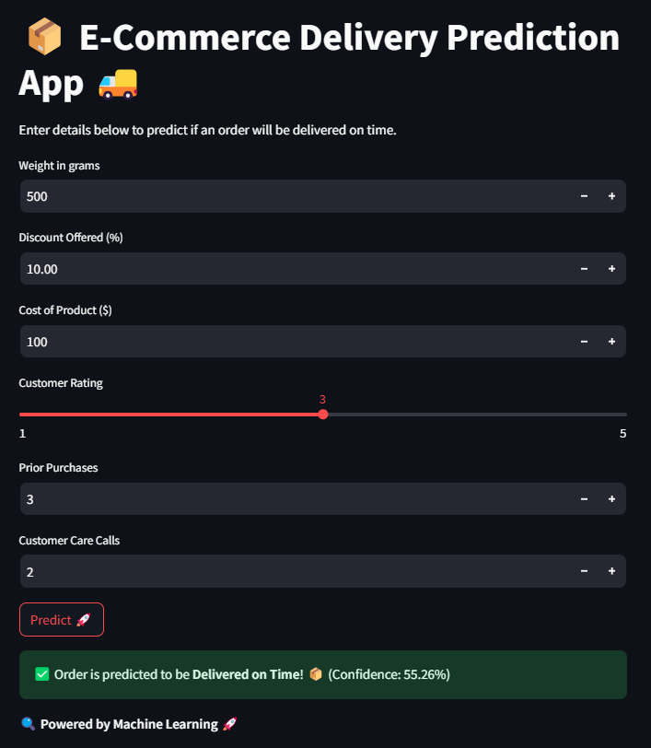
Model Deployment
Why Deploy?
Provides a user-friendly web interface for real-time delivery predictions.
Allows business teams to make data-driven decisions without technical expertise.
Deployment Steps: 1. Trained the best XGBoost model on the full dataset. 2. Saved the model (best_model.pkl) and scaler (scaler.pkl) using Joblib. 3. Built a Streamlit app to take user inputs (Weight, Discount, Cost, etc.). 4. Hosted the app locally to test predictions.
Final Output:
The app predicts whether a product will be delivered on time or delayed.
Simple, interactive UI for easy usage.

Slide 16
Key insights and Recommendation
Key insights
Recommendations
0-10% discounts have the most orders but also the highest late deliveries.
₹200-250 orders generate the most customer calls and delays.
Heavy shipments (>4500g) are more likely to be delayed.
Lower-cost orders (₹50-100) have better on-time delivery rates.
Optimize logistics for bulky shipments to reduce delays.
Improve Customer Support: Focus on high-value orders (₹200-250) to reduce complaints and improve satisfaction.
Prioritize handling of ₹200-250 orders to enhance delivery speed.

Slide 17
Conclusion
Key Insights: Product weight, cost, and customer behavior significantly impact delivery times. Orders with low discounts (0-10%) and frequent customer care calls face more delays.
Final Model Selection: XGBoost was chosen for its highest accuracy (73.31%), strong AUC score (0.8010), and faster training time (0.79 sec).
Recommendations: Optimize logistics for heavy and high-cost products, improve support for delayed orders, and reassess discount strategies.
Final Step: Model successfully deployed using Streamlit for real-time delivery predictions!

Slide 18
Questions ?

Slide 19
Thank You!
-By Abdul Hadi S

